Slide 1
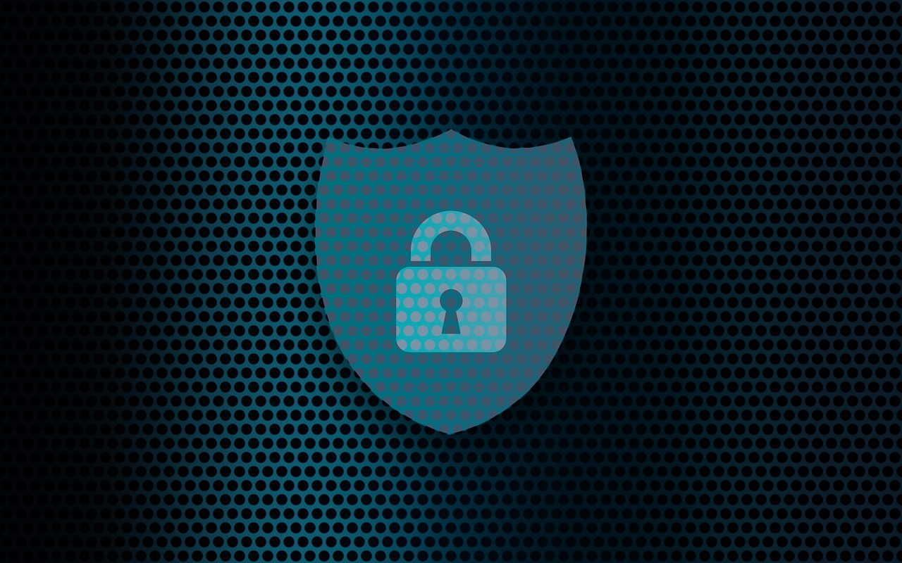
Physical Security
By: Jonathan Kaufman
Christopher Newport University

Slide 2
Outline
What does Physical Security Mean?
Importance of Physical Security
Best Practices

Slide 3
What is Physical Security
Deals with protecting the physical facilities of the organization
Protects all the servers and other IT Equipment
https://meraki.cisco.com/blog/2021/06/merging-physical-security-and-cybersecurity/

Slide 4
Importance of Physical Security
Protects against unauthorized access to servers and other IT systems
Prevents cyber-attacks needing physical access to equipment
https://meraki.cisco.com/blog/2021/06/merging-physical-security-and-cybersecurity/

Slide 5
Best Practices of Physical Security
Install cameras and access control
Use principal of least privilege
Use MFA
Secure entry-points
https://meraki.cisco.com/blog/2021/06/merging-physical-security-and-cybersecurity/

